Slide 1


Title: Bird Observation Analysis
Subtitle: Exploring patterns in bird species diversity, environmental influences, and conservation priorities Prepared by: Shruti Sumadhur Ghosh Contact: shrutisghosh@outlook.com

Slide 2
Slide 2 – Project Overview
Objective:
Assess species diversity across different habitats.
Understand seasonal and environmental influences on bird observations.
Identify habitats & species requiring conservation attention.
Dataset:
Rows: 17,077
Columns: 33
Fields: Species name, date, location, environmental factors, disturbance, watchlist status, etc.

Slide 3
Slide 3 – Data Preparation
Power Query Cleaning Steps:
Removed unnecessary columns and null rows.
Standardized data types (dates, numbers, text).
Created calculated fields:
Month and Month Name from Date.
Temperature Groups and Humidity Groups (binned ranges).
Converted boolean fields to TRUE/FALSE or numeric.
Key Considerations:
Sorting months using Month Number to ensure calendar order.
Logical fields (e.g., PIF_Watchlist_Status) retained for filtering and DAX measures.

Slide 4
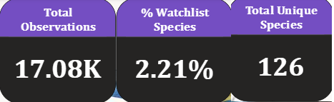
Slide 4 – Key Metrics (KPI Cards)
Total Bird Observations: 17.08K.
Watchlist Species make up only 2.21% of all observations.
Majority of sightings are Non-Watchlist species, indicating stable populations.
Implication:
The dataset is rich in both quantity and variety.
The presence of watchlist species highlights areas requiring attention.

Slide 5
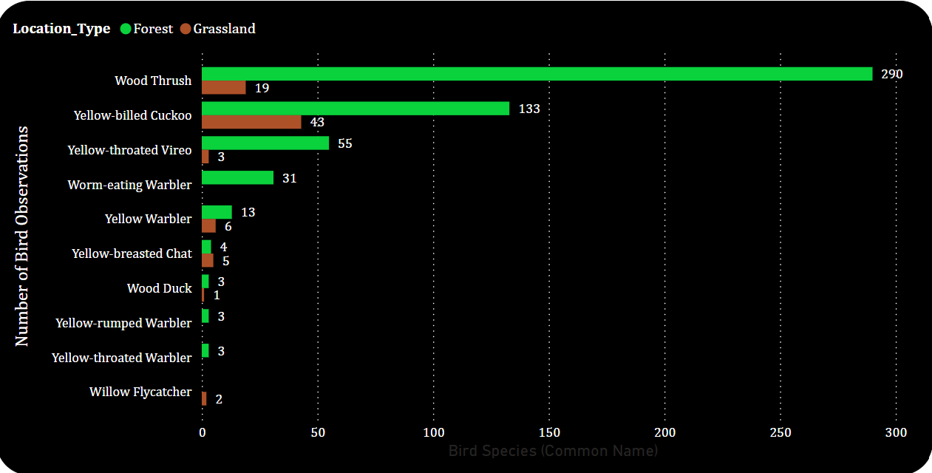
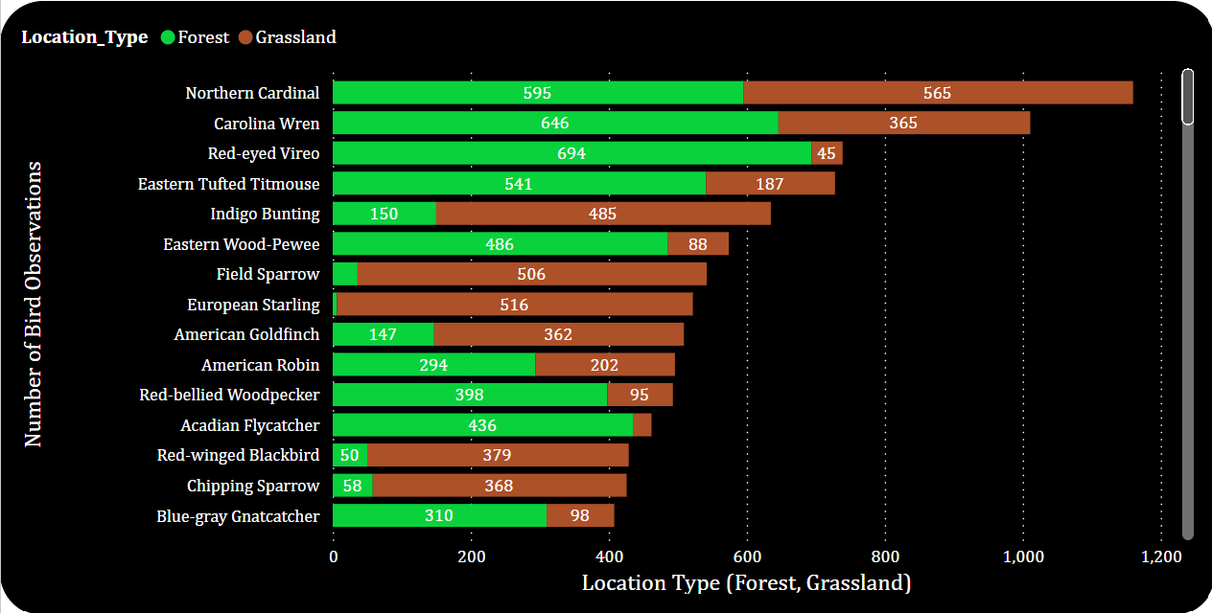
Slide 5 – Species & Location Insights
Top 10 Most Observed Bird Species.
Wood Thrush is the most observed species (Forest: 290, Grassland: 19).
Yellow-billed Cuckoo and Yellow-throated Vireo follow next.
Species diversity is evident across both habitat types.
Observations by Location Type (Forest vs Grassland) chart.
Northern Cardinal and Carolina Wren dominate observations.
Some species like Red-eyed Vireo prefer forests, while others like Field Sparrow are more common in grasslands.
Balanced diversity in both habitat types.

Slide 6
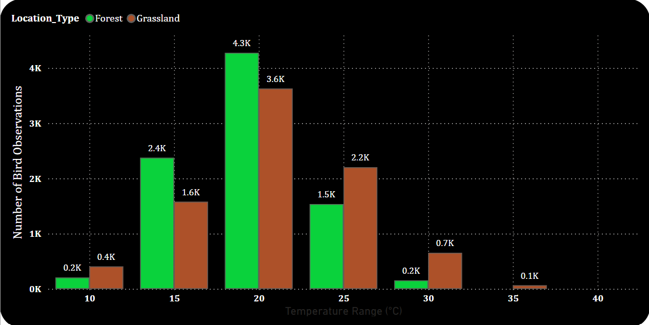
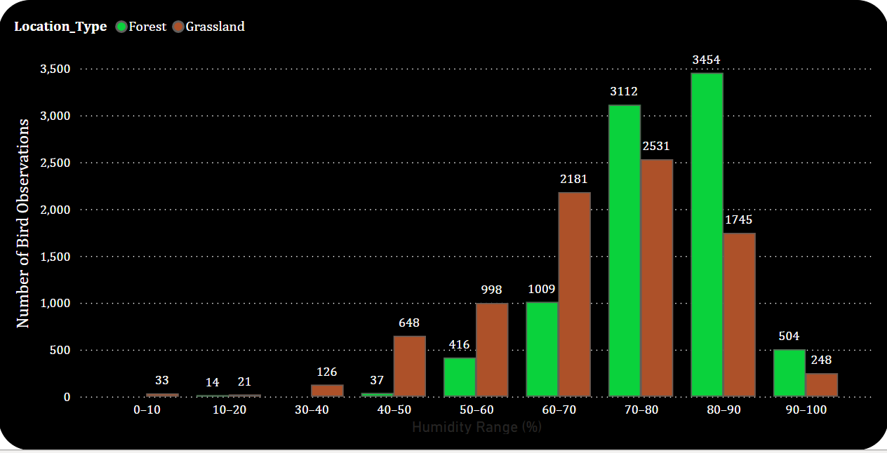
Slide 6 – Environmental Factors
Observations by Humidity Range & Location:
Most observations occur in 70–90% humidity range.
Forests sustain higher counts in extreme humidity compared to grasslands.
Low humidity (<40%) shows very limited sightings.
Number of Bird Observations by Temperature Range & Location:
Highest activity observed between 15°C–25°C.
Grassland species peak at slightly higher temperatures than forest species.
Extreme temperatures reduce sightings significantly.

Slide 7
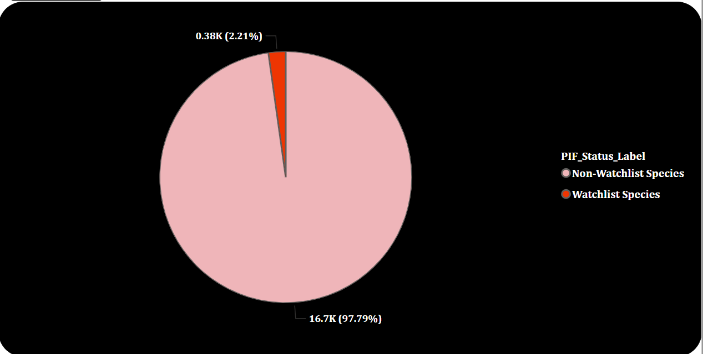
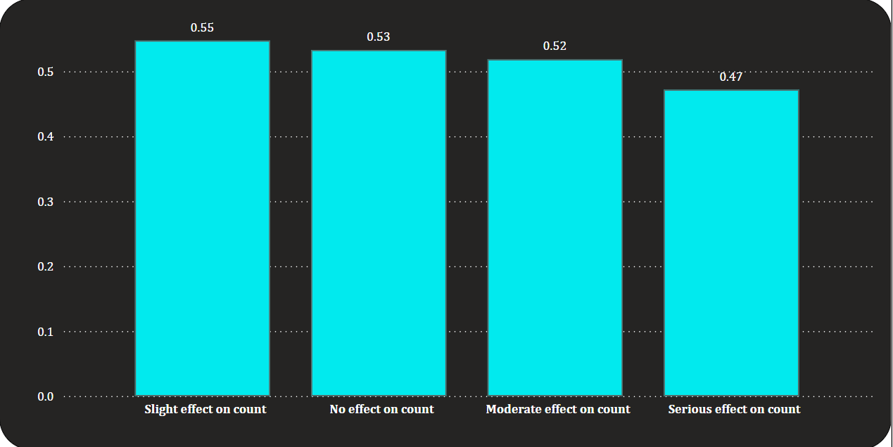
Slide 7 – Conservation Focus
Total Observations & % Watchlist Species:
Total Bird Observations: 17.08K.
Watchlist Species make up only 2.21% of all observations.
Majority of sightings are Non-Watchlist species, indicating stable populations.
Impact of Disturbance on Initial Bird Count :
Slight disturbance results in the highest average counts (0.55).
Serious disturbance reduces counts significantly (0.47).
Moderate and no disturbance conditions are relatively similar.

Slide 8
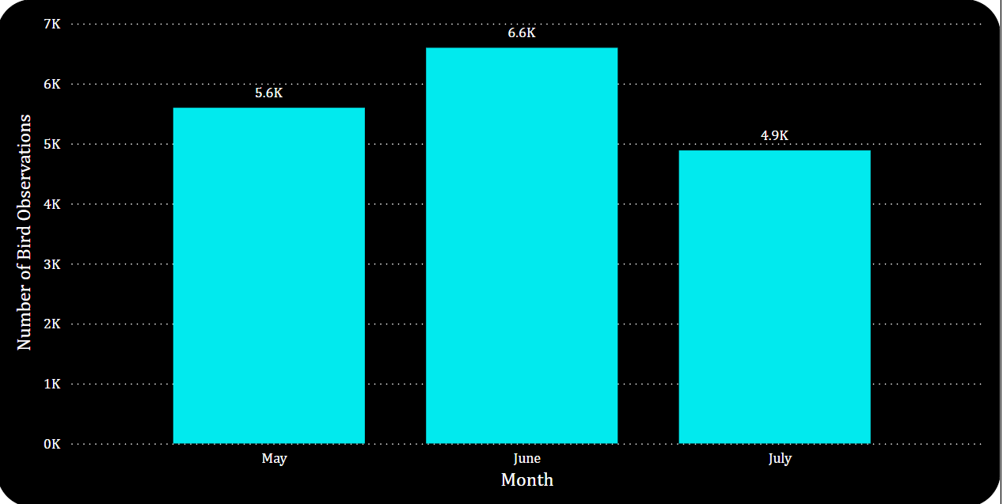
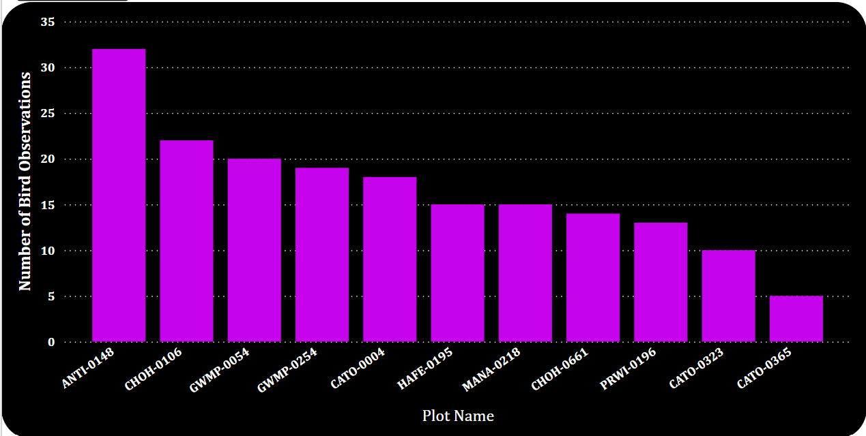
Slide 8 – Seasonal & Spatial Trends
Total Bird Observations per Month:
May: 5.6K observations.
June recorded the highest count at 6.6K.
July saw a decline to 4.9K observations, possibly due to seasonal migration patterns.
Top 10 Plots by Observation Count:
ANTL-0148 leads with over 32 sightings.
CHOH-0106 and GWMP-0054 follow closely.
These high-density plots may represent key bird habitats.

Slide 9
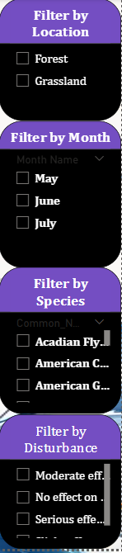
Slide 9 – Filters & Interactivity
Visuals: Screenshot showing slicers (Location Type, Month, Common Name, Disturbance).
Insights:
Slicers allow targeted analysis by season, habitat, or species.
Facilitates quick focus on priority species or habitats.

Slide 10
Slide 10 – Summary & Recommendations
Overall Key Takeaways:
Bird populations vary significantly with habitat type, temperature, and humidity.
Certain plots and species dominate sightings, highlighting biodiversity hotspots.
Disturbance levels directly influence bird presence.
Conservation efforts should prioritize watchlist species and high-density observation plots.
Recommendations:
Prioritize conservation in habitats with high watchlist species.
Manage disturbance factors, especially in sensitive zones.
Align monitoring with seasonal peaks to maximize data yield.

Slide 11
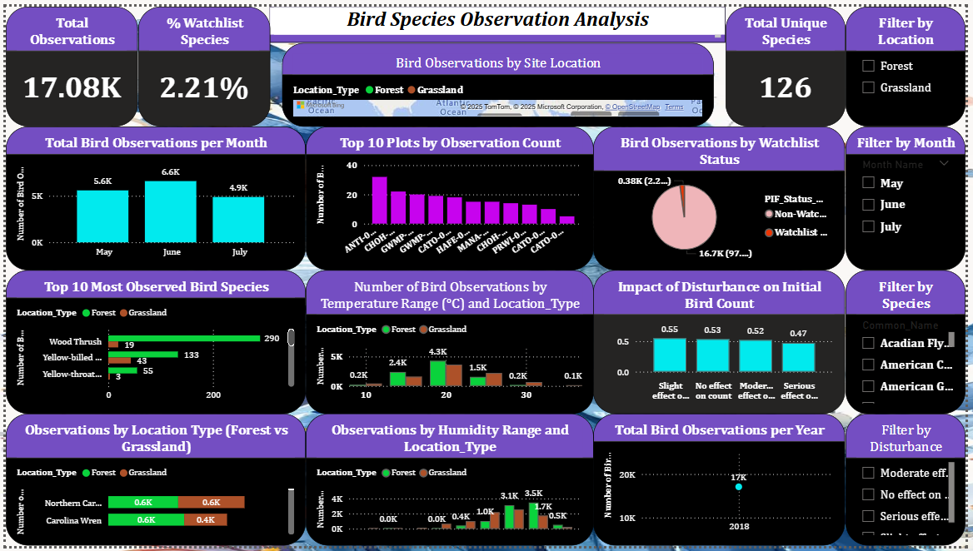
Overview of the Dashboard

Slide 12
Slide 11 – Closing
Title: Thank You Prepared by: Shruti Sumadhur Ghosh
Contact: shrutisghosh@outlook.com

